Slide 1
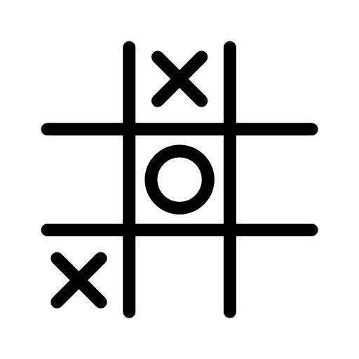
Tic-tac-toe by q-learning
Khandker Sadia Rahman
Department of Computer Science

Slide 2
overview
Project motivation
Main reference
Problem statement
Main idea
Survey
Expected outcome
Plan and milestone
Summary

Slide 3
Project motivation
First introduced to models that require no data in this course
Data driven model e.g., random forest, svm, neural network
Data driven models comes with its own challenges
Unavailability of balanced data
Annotations are expensive
Quite new to reinforcement learning and can’t wait to dive into it

Slide 4

Main reference
Code
Pseudocode
https://www.cs.swarthmore.edu/~meeden/cs63/f11/lab6.php
Video lectures
https://www.youtube.com/playlist?list=PLZbbT5o_s2xoWNVdDudn51XM8lOuZ_Njv
Book chapter
https://www.cs.swarthmore.edu/~meeden/cs63/f11/ml-ch13.pdf
https://github.com/khpeek/Q-learning-Tic-Tac-Toe

Slide 5


Problem Statement
x is the human player
o is the q learned player
Consists of two players: x and o
Model a program using Q learning so it learns to play tic-tac-toe
Goal is to train the q learned player so it can compete with the human player

Slide 6




MAIN IDEA
Components of the model: agent, environment, state, action, reward
Goal is to use Q learning to maximize the total reward it receives.
At time $t$, the tic-tac-toe agent receives the current state, $S_{t}$
At time 𝑡, the tic-tac-toe agent receives the current state, 𝑆_𝑡
Depending on this state, the agent takes an action, $A_{t}$ following a policy $π$
Depending on this state, the agent takes an action, 𝐴_𝑡 following a policy 𝜋
Receives a reward $R_{t+1}$ for the action
Receives a reward 𝑅_(𝑡+1) for the action
Agent
$$S_{t}$$
$$A_{t}$$
$$R_{t+1}$$
Environment

Slide 7
survey
Tic-tac-toe with Minimax algorithms
Tic-tac-toe with Tabular Q-learning
Tic-tac-toe with Monte Carlo Tree Search (MCTS)
Tic-tac-toe with neural network

Slide 8
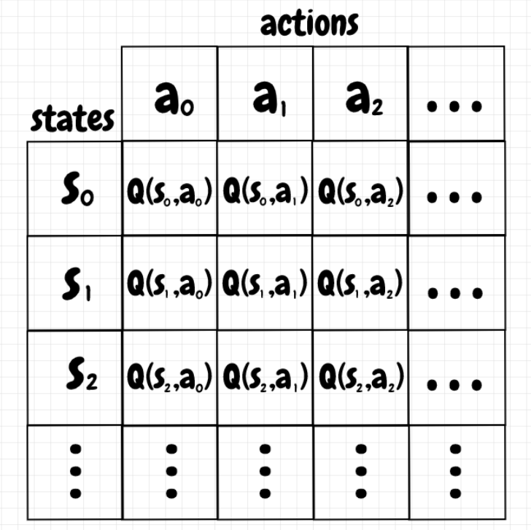
Tic-tac-toe with tabular Q-learning
Creates a table consisting of all possible states and action at each axis correspondingly
Q-value in each cell indicates whether it is a good idea to take that action from the current state
Picture courtesy: https://nestedsoftware.com/2019/07/25/tic-tac-toe-with-tabular-q-learning-1kdn.139811.html

Slide 9
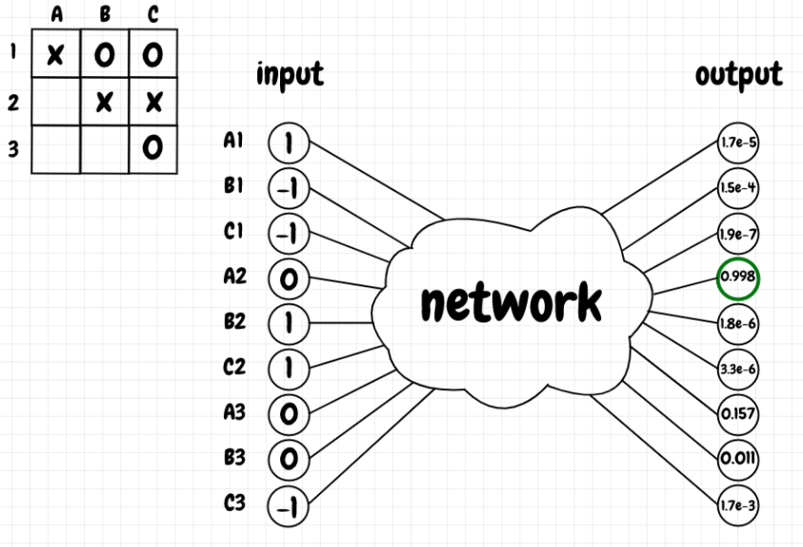
Tic-tac-toe with neural network
Input: tic-tac-toe positions
Output: list of Q-values corresponding to each move
Neural network approximates the Q-table
Picture courtesy: https://nestedsoftware.com/2019/12/27/tic-tac-toe-with-a-neural-network-1fjn.206436.html

Slide 10
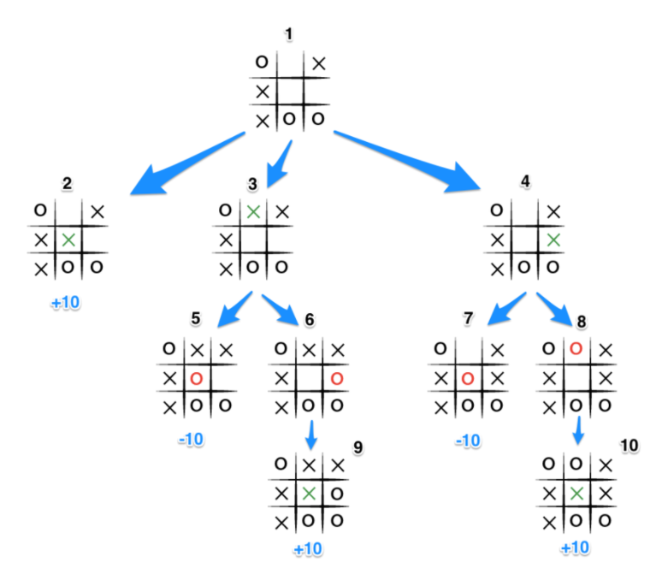
Tic-tac-toe with minimax algorithm
Minimax is a back-and-forth algorithm
The player tries to maximize the score and the opposing player tries to minimize the score
The player looks a few steps ahead and evaluates the moves of the minimizer to select the maximum score it can get.
Picture courtesy https://www.neverstopbuilding.com/blog/minimax

Slide 11
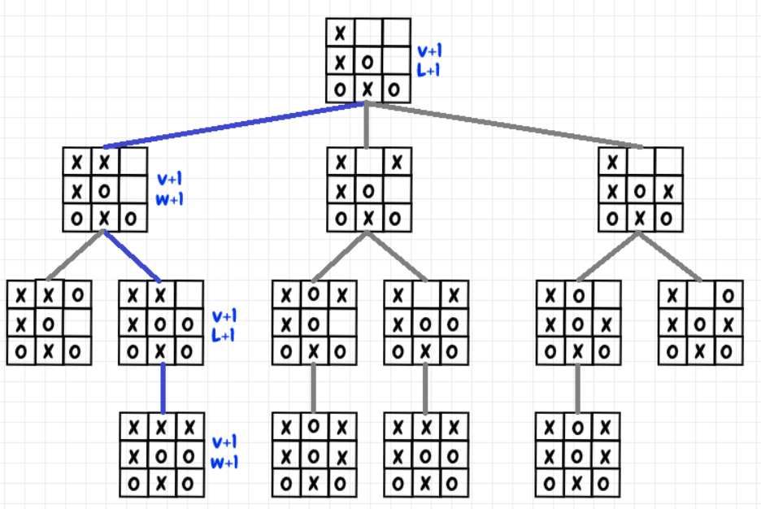
Tic-tac-toe with mcts
Monte Carlo Tree search is a heuristic search algorithm
Like minimax, it evaluates the current state and a few more steps ahead to determine an optimal solution.
But unlike minimax, it works well in games with large number of branches
As it can give a sufficiently optimal solution from a partially constructed tree
Picture courtesy: https://nestedsoftware.com/2019/08/07/tic-tac-toe-with-mcts-2h5k.152104.html

Slide 12
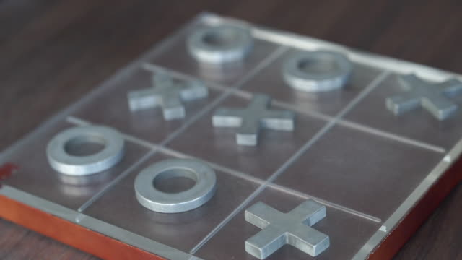
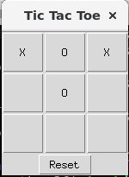
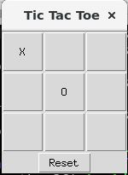
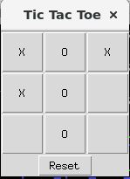
Expected outcome
Fully functional tic-tac-toe game

Slide 13

Plan and milestone
Dates | Tentative goals
9/28/2021 | Initial presentation
10/12/2021 | Conceptual understanding on Q learning
10/26/2021 | Implementation of the pseudocode and code
11/9/2021 | Mid presentation
11/23/2021 | Debug the code and have it running
11/30/2021 | Final presentation

Slide 14
summary
In depth understanding
Of Q-learning and its application
Demonstrate
A fun application of Q-learning via tic-tac-toe
Basic understanding
Of reinforcement learning and its application

Slide 15


Thank you

Slide 16

Appendix

Slide 17
References
https://www.pico.net/kb/what-algorithm-for-a-tic-tac-toe-game-can-i-use-to-determine-the-best-move-for-the-ai/
https://www.neverstopbuilding.com/blog/minimax
https://web.archive.org/web/20200507202433id_/https://www.annualreviews.org/doi/pdf/10.1146/annurev-statistics-031219-041220
https://nestedsoftware.com/2019/12/27/tic-tac-toe-with-a-neural-network-1fjn.206436.html

